Slide 1
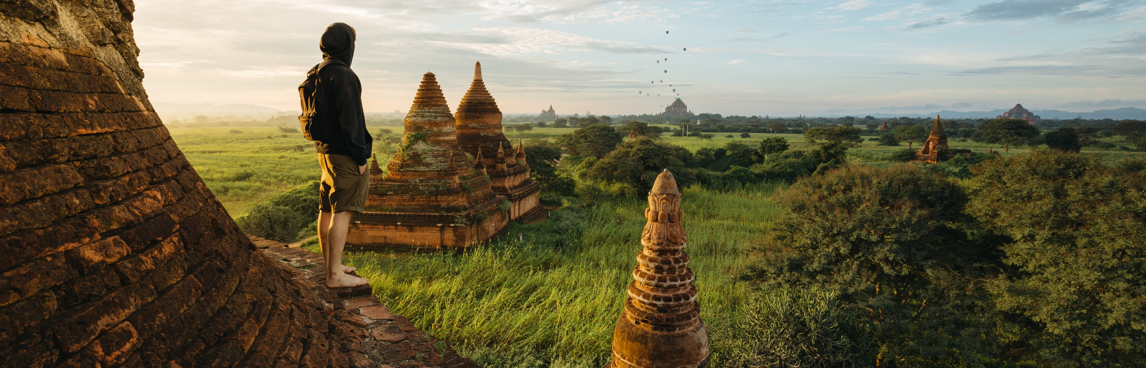
What Will We Do?
Activity Planning: A week with Family needs lots of options…

Slide 2
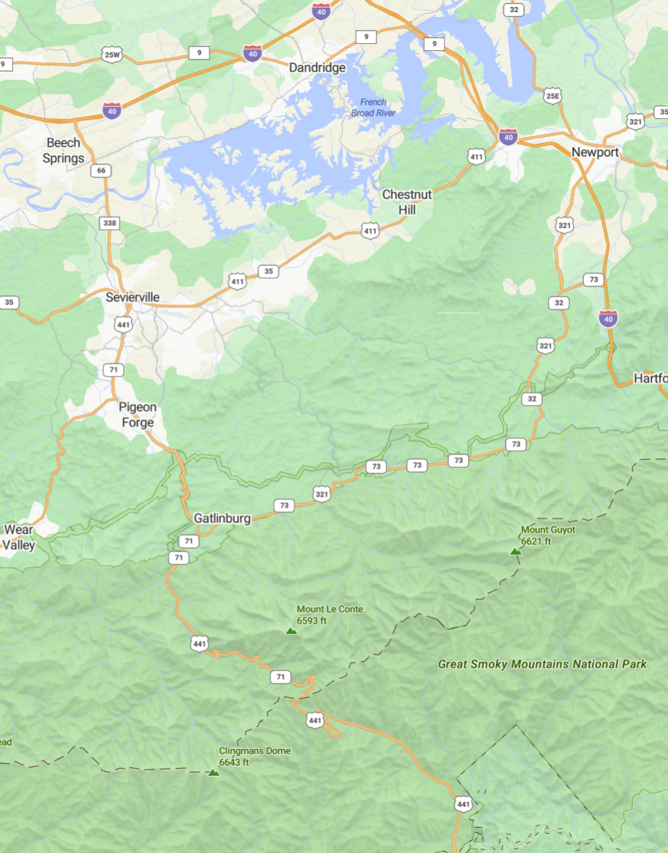
Where Are We?
Pigeon Forge
Gatlinburg – 25 Min.
Sevierville – 25 Min.
Great Smokey Mountain National Park – 33 Min.
Knoxville– 59 Min.

Slide 3

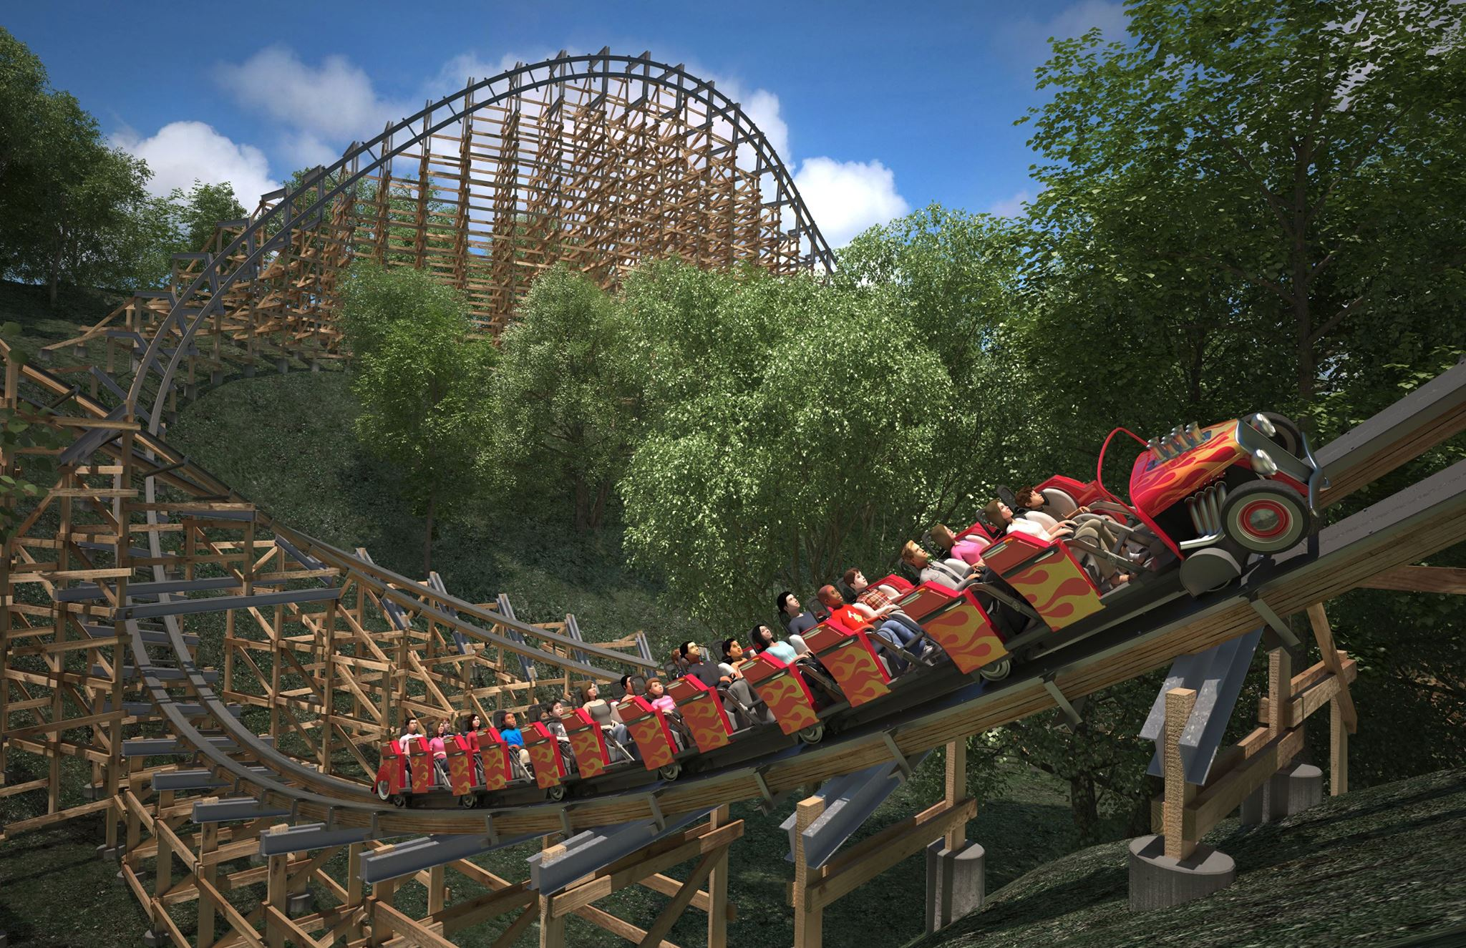
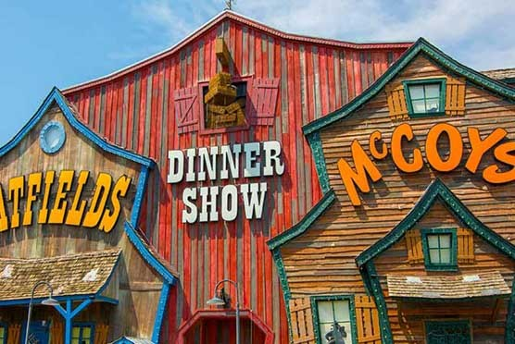
Choose an Experience
Adventure
Enthusiasm
Culture & Arts

Slide 4
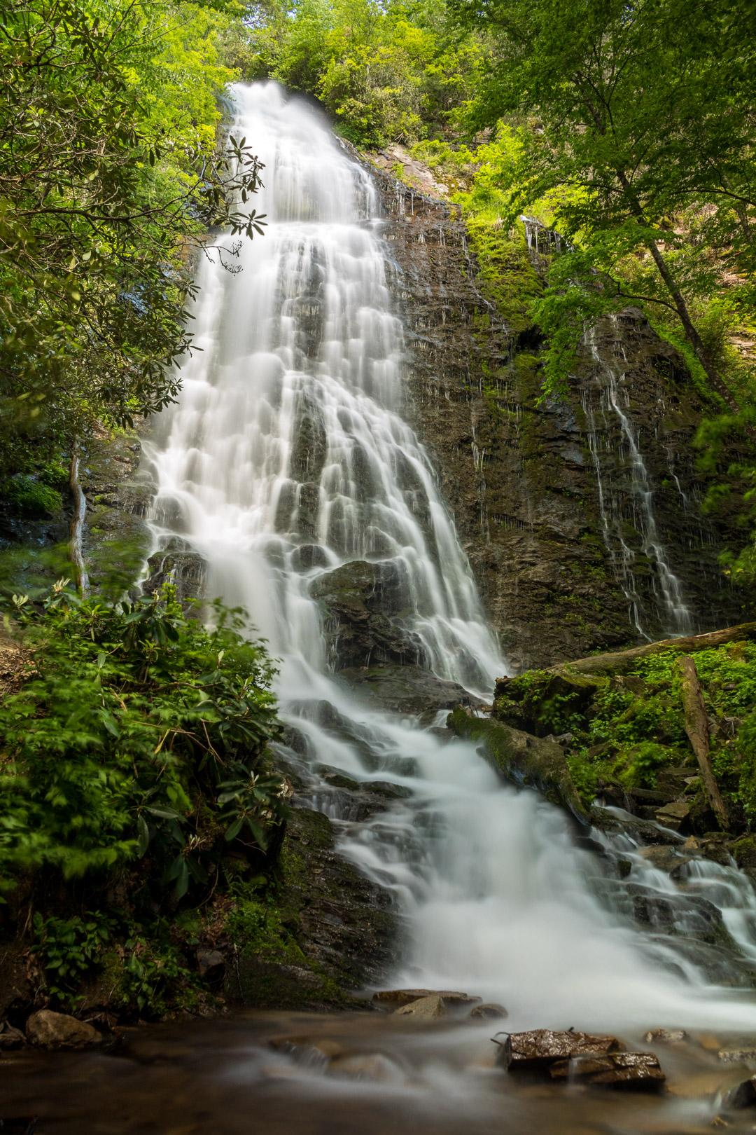
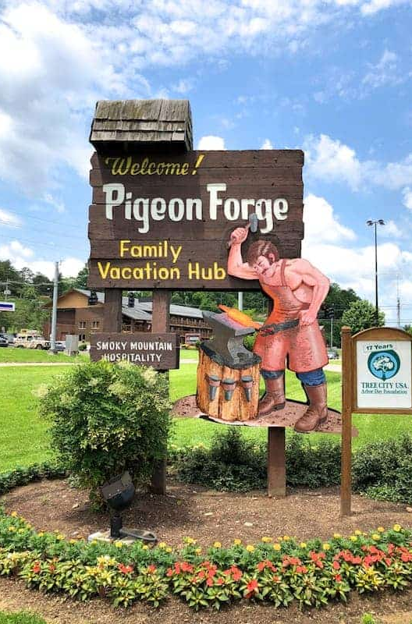


Adventure
Hikes
Laurel Falls Trail: Easy – 2.4 Miles – 1.5 Hrs.
Highlights include beautiful waterfalls and scenic views along the trail. Challenges include steep inclines and slippery rocks. Starting early and wearing good shoes are recommended
Kuwohi Observation Tower Trail: Moderate – 1.3 Miles – 1 Hrs.
Clingmans Dome, the top of the Smokeys, Paved Trail, Steep at Times, Observation Deck at the top.
Grotto Falls via Trillium Gap Trail: Moderate – 2.6 Miles – 1.5 Hrs.
Waterfalls with the ability to walk behind them.
Rainbow Falls Trail: Moderate – 5.4 Miles – 3.5 Hours
Nice hike with a couple of small waterfalls starting near a before creek, ending at the top with a very large waterfall. Steep
Chimney Tops Trail: Hard – 3.6 Miles – 3 Hrs.
Highlights include beautiful views, well-maintained paths, and scenic water crossings. Challenges involve steep inclines and numerous stairs
Alum Cave Trail to Mount LeConte: Hard – 11 Miles – 9+ Hrs.

Slide 5
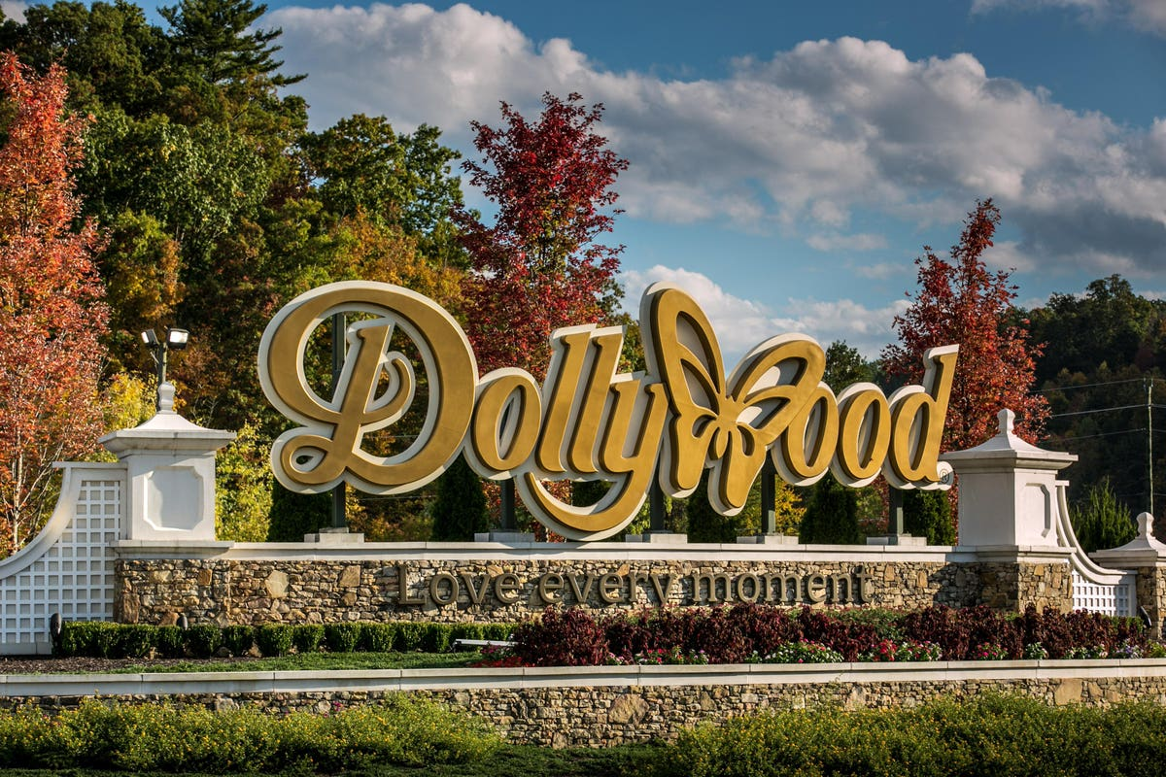

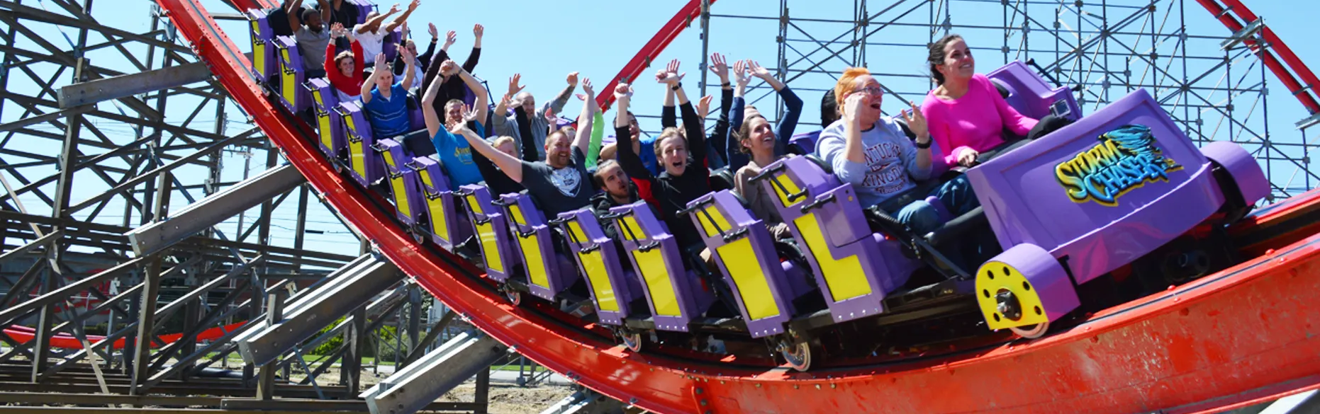
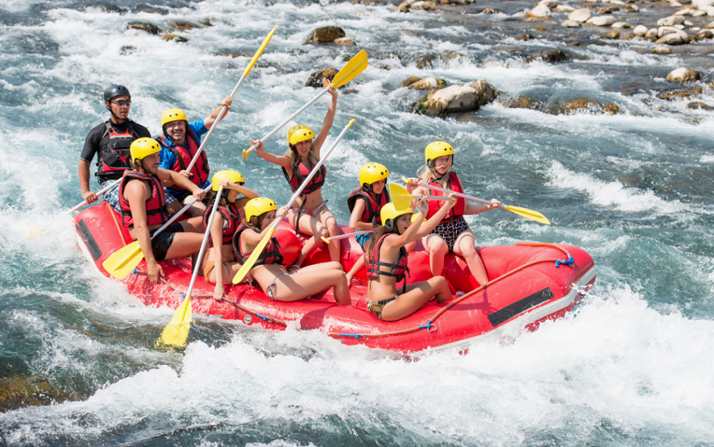
Enthusiasm
Attractions
Ripley's Believe or Not
Alpine Coasters
Mini Golf
Escape Rooms
CLICK HERE Gatlinburg
CLICK HERE Pigeon Forge
White Water Rafting
Upper Pigeon River Rafting
Class 3 and 4 Rapids
8 and up or 70lbs
Lower Pigeon River Rafting
Calm Waters
Ages 3-7

Slide 6

Culture & Arts
Attractions
Ripley's Believe or Not
Alpine Coasters
Mini Golf
Escape Rooms
CLICK HERE Gatlinburg
CLICK HERE Pigeon Forge
White Water Rafting
Upper Pigeon River Rafting
Class 3 and 4 Rapids
8 and up or 70lbs
Lower Pigeon River Rafting
Calm Waters
Ages 3-7

Slide 7
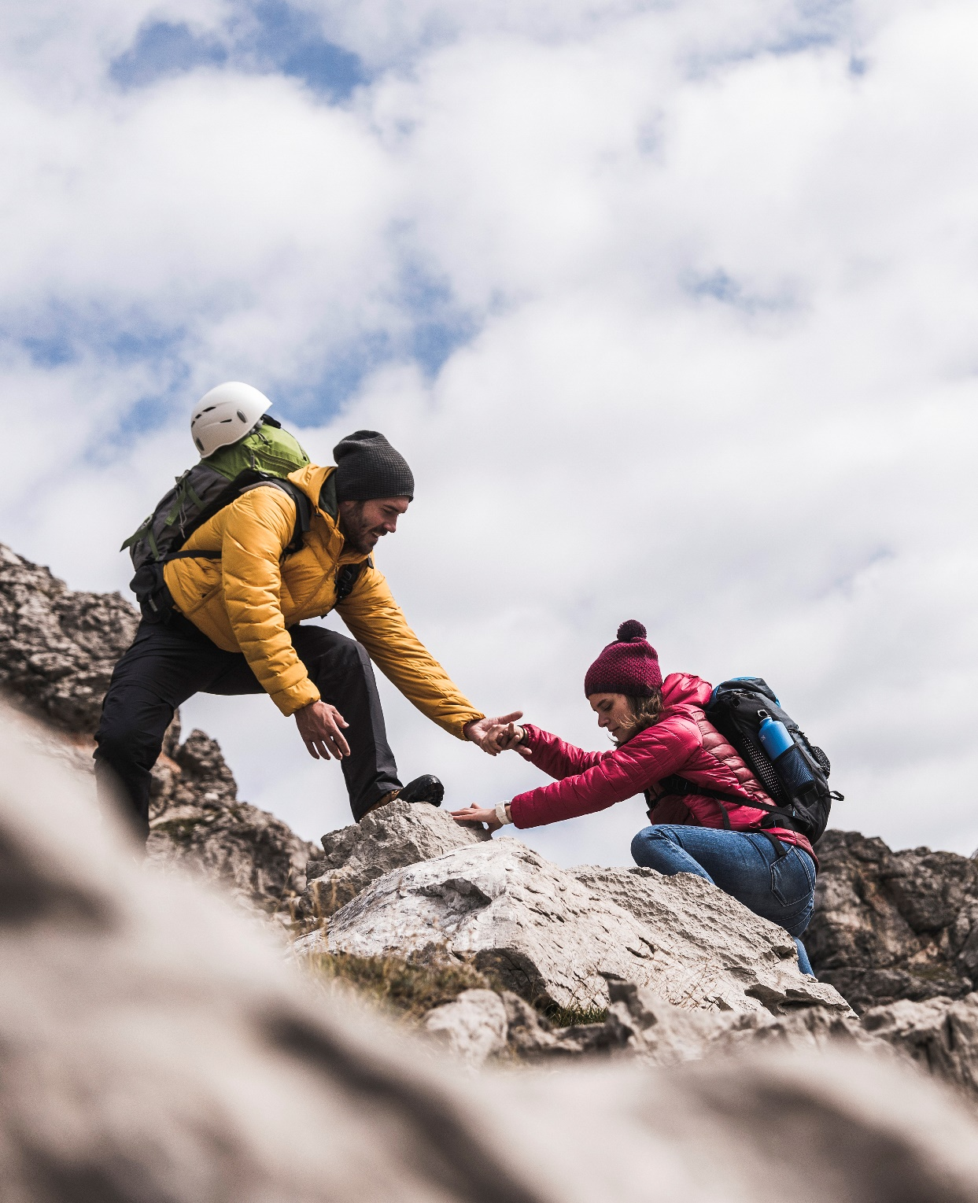
Thank You

